Slide 1

Chapter 12
Information Systems

Slide 2
Chapter Goals
Define the role of general information systems
Explain how spreadsheets are organized
Create spreadsheets for basic analysis of data
Define appropriate spreadsheet formulas using built-in functions
Design spreadsheets to be flexible and extensible
Describe the elements of a database management system

Slide 3
Chapter Goals
Describe the organization of a relational database
Establish relationships among elements in a database
Write basic SQL statements
Describe an entity-relationship diagram
Define and explain the role of e-commerce in society today

Slide 4
Managing Information
Information system
Software that helps the user organize and analyze data
Electronic spreadsheets and database management systems
Software tools that allow the user to organize, manage, and analyze data in various ways
Have you ever used a spreadsheet?

Slide 5
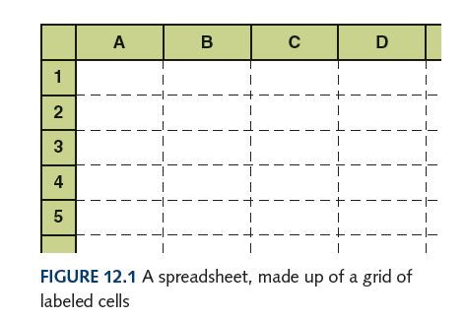
Spreadsheets
Spreadsheet
A software application that allows the user to organize and analyze data using a grid of labeled cells
  A cell can contain data or a formula that is used to calculate a value
  Data stored in a cell can be text, numbers, or “special” data such as dates
  Spreadsheet cells are referenced by their row and column designation

Slide 6
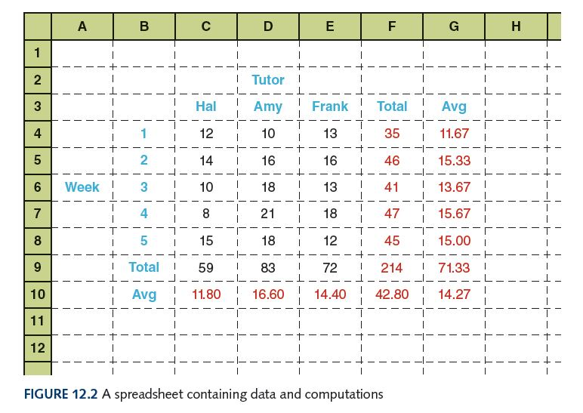
Spreadsheets
Suppose we have collected data on the number of students that came to get help from a set of tutors over a period of several weeks

Slide 7
Spreadsheet Formulas
The power of spreadsheets comes from the formulas that we can create and store in cells
  When a formula is stored in a cell, the result of the formula is displayed in the cell
  If we’ve set up the spreadsheet correctly, we could
    add or remove tutors.
    add additional weeks of data.
    change any of the data we have already stored and the corresponding calculations would automatically be updated.

Slide 8
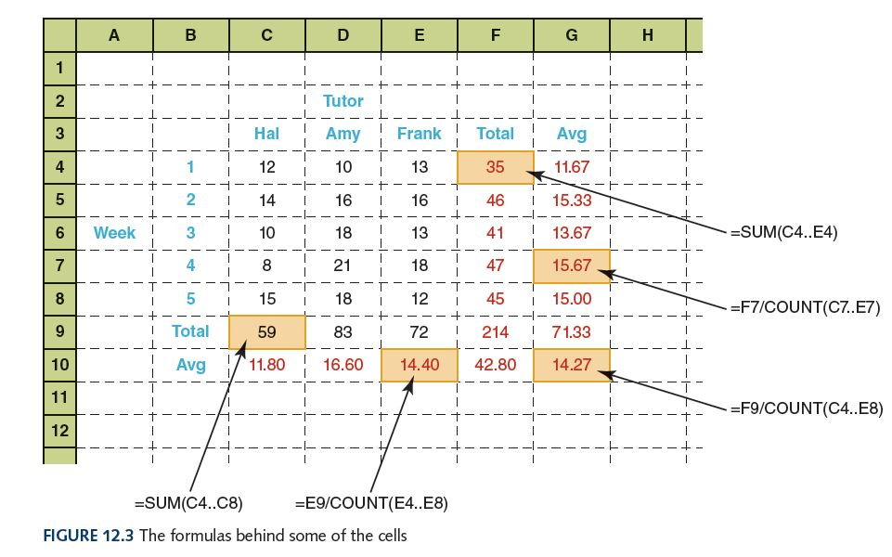
Spreadsheet Formulas

Slide 9
Spreadsheet Formulas
Formulas make use of basic arithmetic operations using the standard symbols (+, -, 2, *, and /)
Spreadsheet functions
Computations provided by the spreadsheet software that can be incorporated into formulas
Range
A set of contiguous cells specified by the endpoints

Slide 10
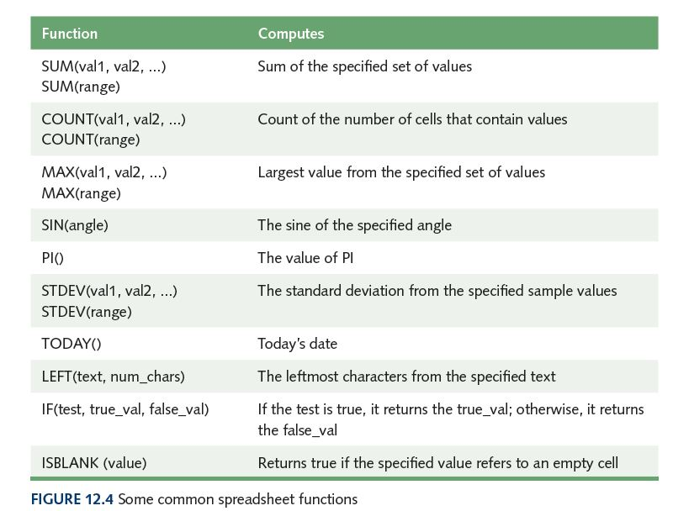
Spreadsheet Formulas

Slide 11
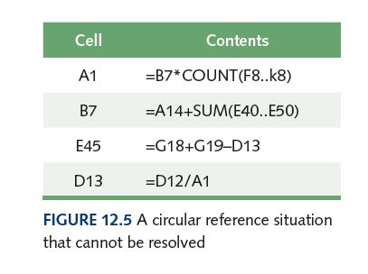
Circular References
Circular reference
A set of formulas that ultimately rely on each other
Can you see
the circular
reference?

Slide 12
Spreadsheet Analysis
Can you name eight tasks that a spreadsheet might be used to perform?

Slide 13
Spreadsheet Analysis
Possible tasks a spreadsheet could perform:
Track sales
Analyze sport statistics
Maintain student grades
Keep a car maintenance log
Record and summarize travel expenses
Track project activities and schedules
Plan stock purchases

Slide 14
Spreadsheet Analysis
Spreadsheets are also useful because of their dynamic nature, which provides the powerful ability to do what-if analysis
  What if the number of attendees decreased by 10%?
  What if we increase the ticket price by $5?
  What if we could reduce the cost of materials by half?

Slide 15
Database Management Systems
Database
A structured set of data
Database management system (DBMS)
A combination of software and data, made up of a physical database, a database engine, and a database schema
Physical database
A collection of files that contain the data

Slide 16
Database Management Systems
Database engine
Software that supports access to and modification of the database contents
Database schema
A specification of the logical structure of the data stored in the database
Database query
A request to retrieve data from a database

Slide 17
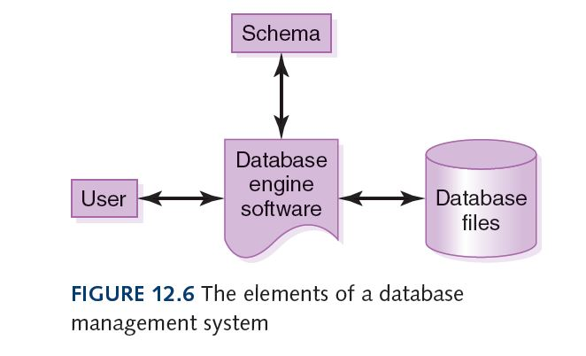
Database Management Systems

Slide 18
The Relational Model
Relational DBMS
A DBMS in which the data items and the relationships among them are organized into tables
Tables
A collection of records
Records (object, entity)
A collection of related fields that make up a single database entry
Fields (attributes)
A single value in a database record

Slide 19
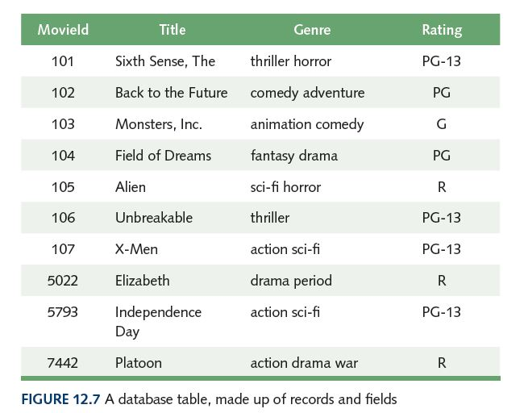
A Database Table
How do we
uniquely
identify a
record?

Slide 20
A Database Table
Key
One or more fields of a database record that uniquely identifies it among all other records in the table
We can express the schema for this part of the database as follows:
  Movie (MovieId:key, Title, Genre, Rating)

Slide 21
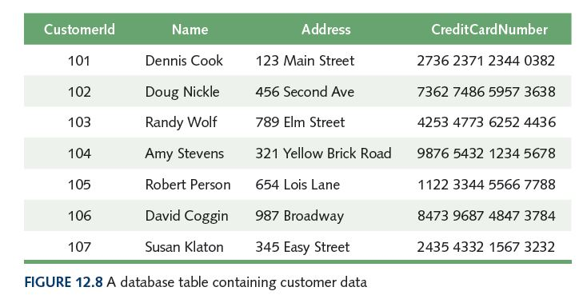
A Database Table

Slide 22
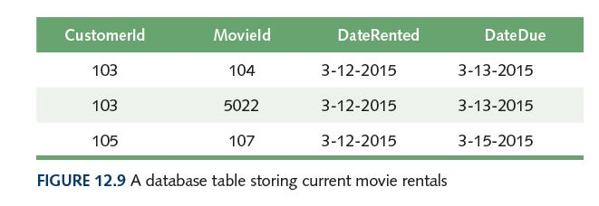
Relationships
How do we relate movies to customers?
By a table, of course!
Who is
renting
what
movie?

Slide 23
Structured Query Language
Structured Query Language (SQL)
A comprehensive relational database language for data manipulation and queries
select attribute-list from table-list where condition
name of field name of table value restriction
select Title from Movie where Rating = 'PG'
Result is a table containing all PG movies in table Movie

Slide 24
Queries in SQL
select Name, Address from Customer
select * from Movie where Genre like '%action%'
select * from Movie where Rating = 'R' order by Title
What does each of these
queries return?

Slide 25
Modifying Database Content
insert into Customer values (9876, 'John Smith', '602 Greenbriar Court', '2938 3212 3402 0299')
update Movie set Genre = 'thriller drama' where title = 'Unbreakable'
delete from Movie where Rating = 'R'
What does each of these
statements do?

Slide 26
Database Design
Entity-relationship (ER) modeling
A popular technique for designing relational databases
ER Diagram
A graphical representation of an ER model
Cardinality constraint
The number of relationships that may exist at one time among entities in an ER diagram

Slide 27
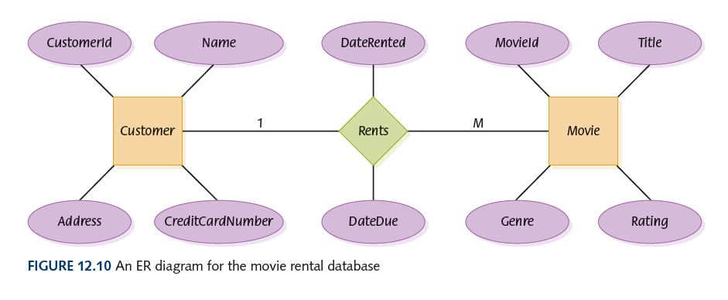
Database Design
How many movies can a person rent?
How many people can rent the same movie?

Slide 28
E-Commerce
Electronic commerce
The process of buying and selling products
and services using the Web.
Can you name at least 4 e-commerce sites
that you have visited lately?
What made e-commerce feasible and easy?
What problems does e-commerce face?

Slide 29
Ethical Issues
Politics and the Internet: Candidate’s View
What was the $100 revolution?
In what ways did both Obama and McCain use the Internet in the 2008 election?
How did television influence the 1960 presidential election?

Slide 30
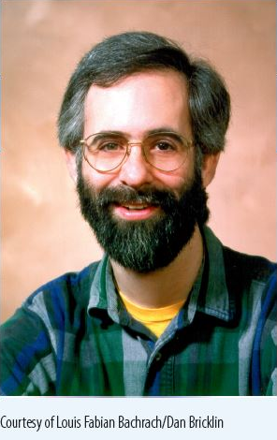
Who am I?
What software
product did I
win the Hopper
Award for in
1981?
I believe that
software should
not be
proprietary, so I
did not patent
this product.

Slide 31
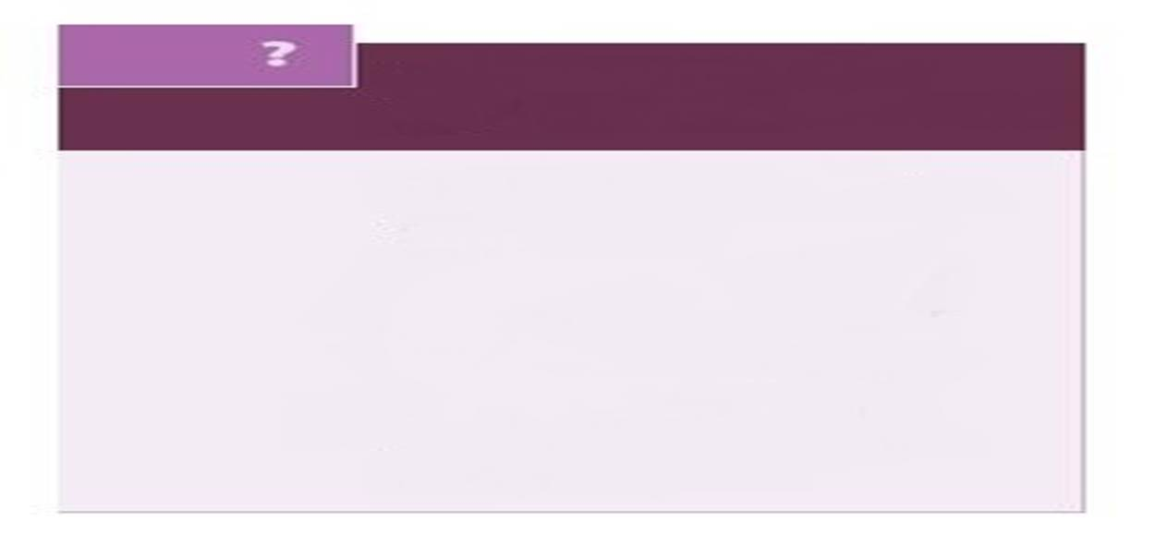
Do you know?
What data does the Ellis Island database contain?
How does Lively make elder care more manageable?
What should you do if you receive an email from an unknown source that promises to make you rich?
For what did E. F. Codd win the Turing Award in 1981?
What are the implications of secondhand shopping?

